Slide 1

Automatic Alignment of Long Syllables in
A Cappella Beijing Opera
Georgi Dzhambazov, Yile Yang, Rafael Caro, Xavier Serra
CompMusic Project – Universitat Pompeu Fabra
georgi.dzhambazov@upf.edu
6th International Workshop on Folk Music Analysis
Dublin Institute of Technology
17 June 2016

Slide 2
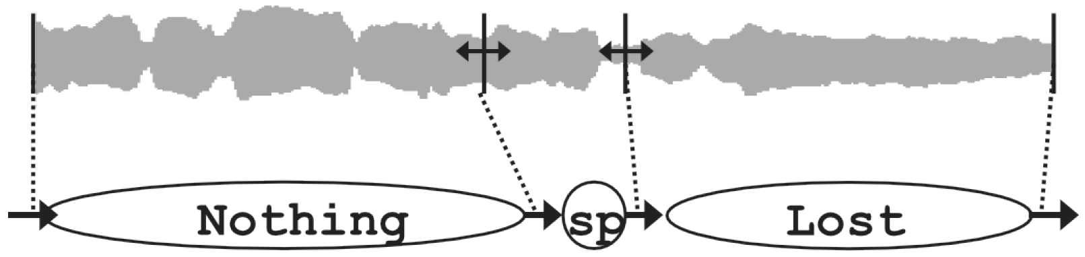
Introduction
What is lyrics-to-audio alignment? automatic matching between an audio recording and its lyrics: phrases/words/syllables
State-of-the-art approaches:
overview in (Fujihara, 2012)
Most work is on pop music with speech-adopted approach
methodology | training | evaluation dataset
phoneme recognizer | speech | English pop, Japanese pop, Cantonese pop
Notes:
State of the art: Deezer and spotify

Slide 3
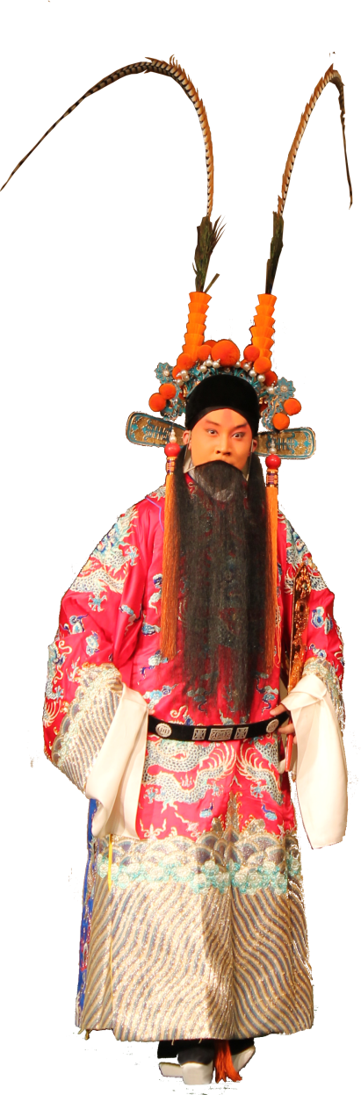
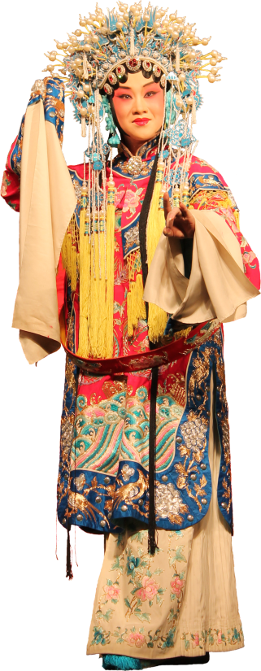
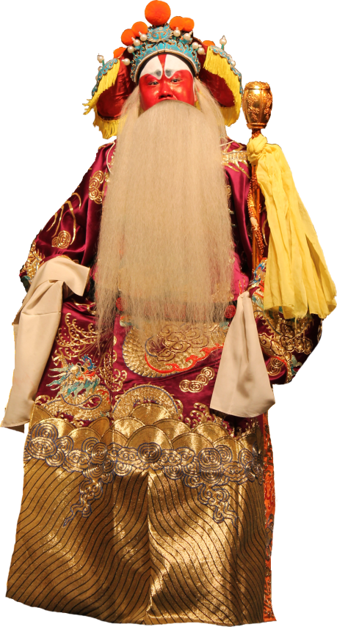
What is Beijing opera (a.k.a. Jingju)
Unique singing style
Language: Mandarin + dialects
Different metrical patterns (banshi):
manban (slow)
kuaiban (fast)
Different role types
dan
laosheng
jing
Notes:
Banshis change within a song: usually from slow to fast.

Slide 4
Example excerpt from an aria
Average duration: 3.1 sec
Max duration: 8 sec
Notes:
Tenney and Polansky 1980
Cambouropoulos, 2001, 2006
Information Dynamics Of Music or IDyOM Pearce 2005, based on multiple viewpoints Conklin 1995

Slide 5
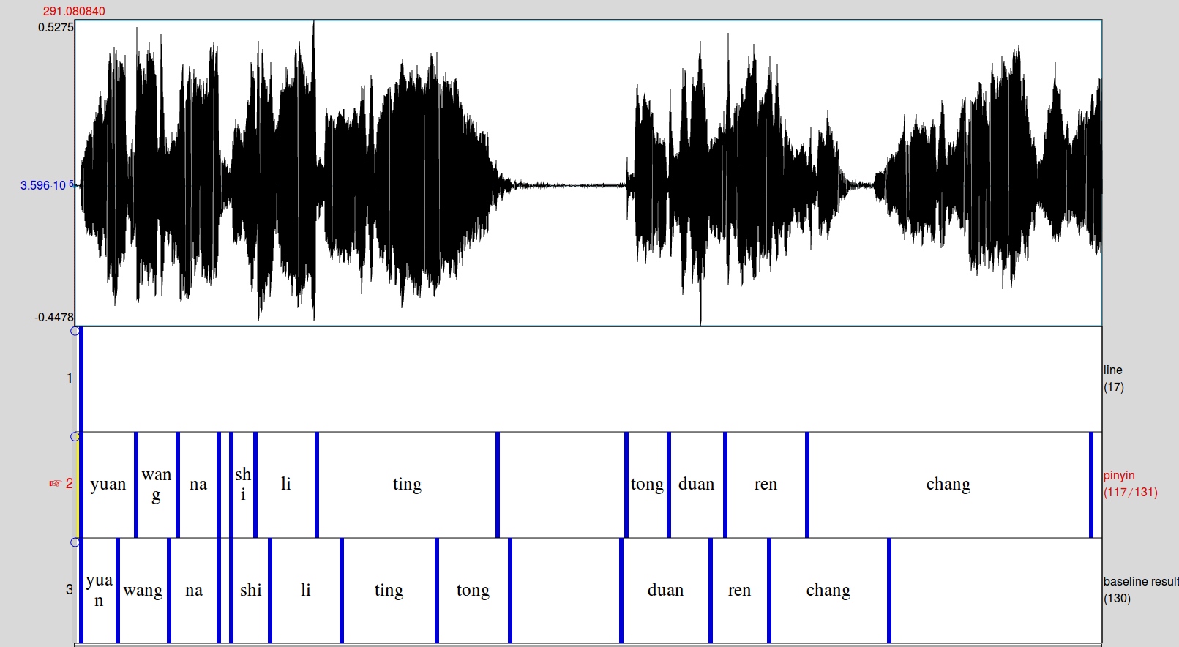
Example excerpt from an aria:
performance of baseline with phonetic recognizer
Premature transition to next syllable for long syllables
Notes:
Tenney and Polansky 1980
Cambouropoulos, 2001, 2006
Information Dynamics Of Music or IDyOM Pearce 2005, based on multiple viewpoints Conklin 1995

Slide 6
Motivation
Why alignment?
To facilitate navigation
For musicological studies
For singing students and teachers
Why design a new alignment method?
Application of state-of-the-art phonetic recognizer:
Not satisfactory results
Unaware of music-specific knowledge
Notes:
Students to compare singing of two masters of same aria

Slide 7
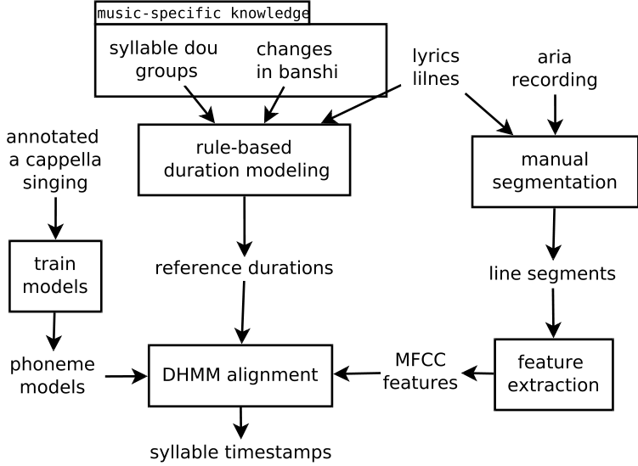
Approach Overview

Slide 8
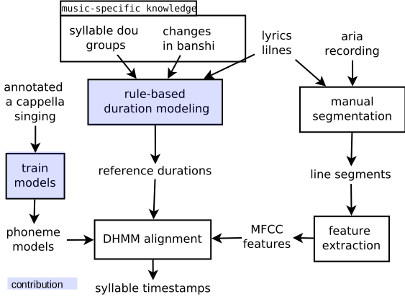
Approach Overview

Slide 9
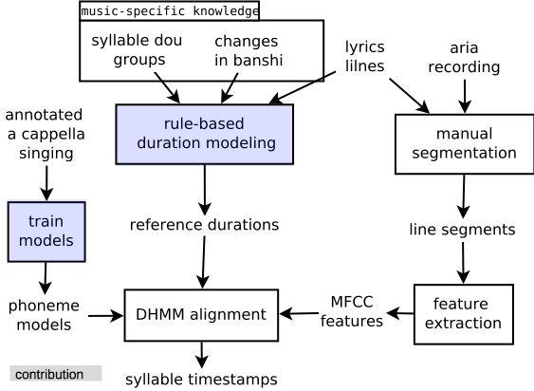
Approach Overview

Slide 10
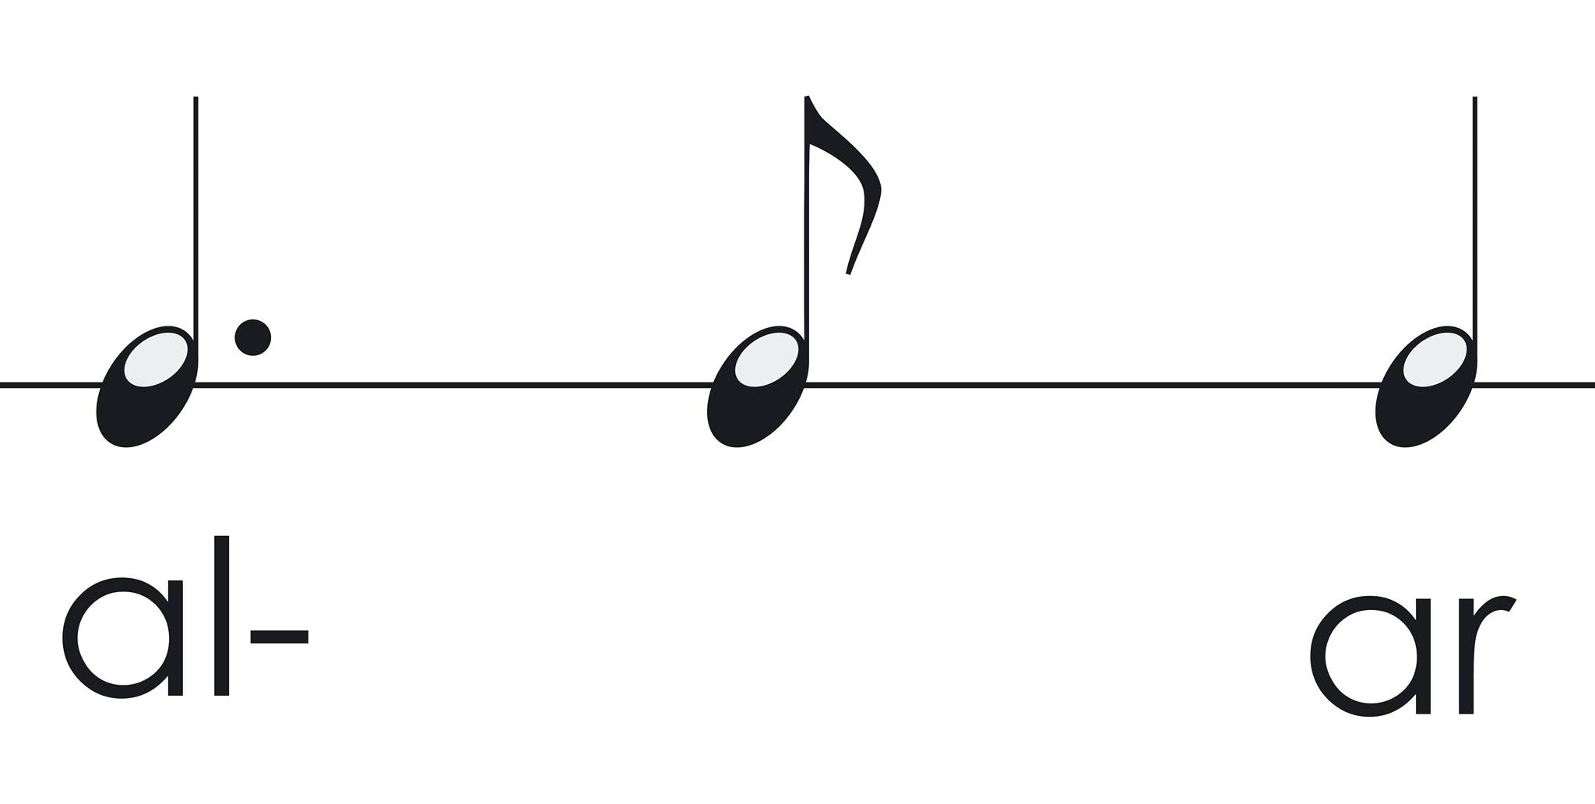
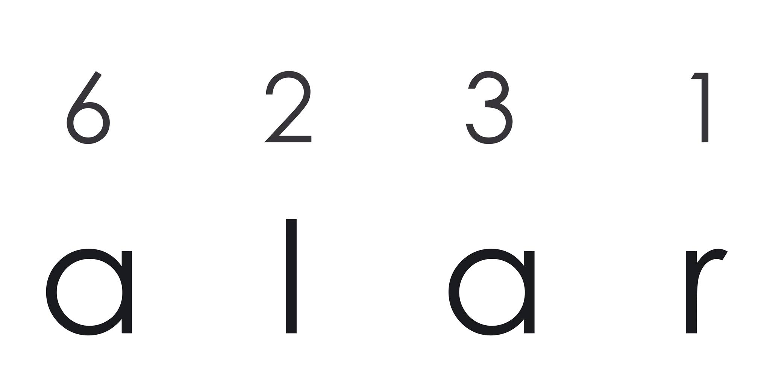
Syllable reference durations: model from score?
(Dzhambazov et al. 2015)
Restriction: need of musical score
Notes:
In Jingju singers dont follow durations in score

Slide 11

Syllable reference durations: model from training data?
(Kruspe et al. 2015)
Restriction: looses context (position of a syllable in a line)

Slide 12

Jingju-specific principles
Lyrics from poetry: divided into lines
Each line has 2 or 3 dou groups
Each dou ends with a key syllable
玉堂春含悲泪忙往前进，
想起了当年事好不伤情！
每日里在院中缠头似锦，
到如今只落得罪衣罪裙。
dou
dou
dou

Slide 13
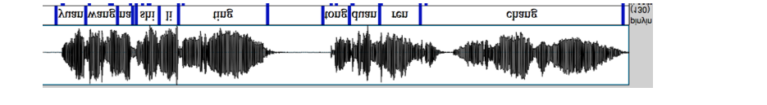
Derivation of phoneme reference durations
Assign ratios from total line durations to key syllables
Split syllable durations into phoneme reference durations
1/5
1/4
1/3
Notes:
Stretch to fit a line – audio for a lyrics line is manually segmented
Split into phonemes according to simple rules

Slide 14
Approach Overview

Slide 15
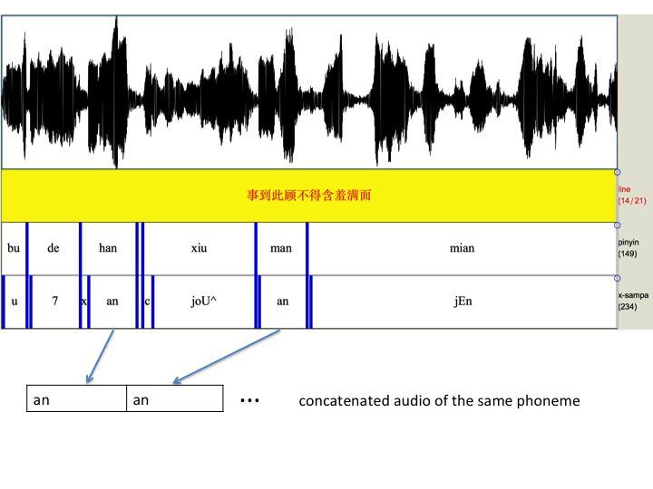
Phoneme models
Phoneme models
Train on singing voice with concatenated excerpts
29 phonemes + silence: GMM with MFCCs
Notes:
Why? No phoneme

Slide 16
Approach Overview

Slide 17
Duration-explicit hidden Markov model (DHMM)
Assign normal distributions centered at phoneme reference durations
Assign exponential distributions at inter-word silences
syllable1
syllable2
syllable3
Notes:
Remember that baseline was transiting on long syllables prematurely.
Wait time in a state decreases according to a exponential distribution

Slide 18
Duration-explicit hidden Markov model
Consider the sequence of phonemes as a HMM
Forced Viterbi alignment
Maximize duration at each phoneme according to assigned distributions

Slide 19
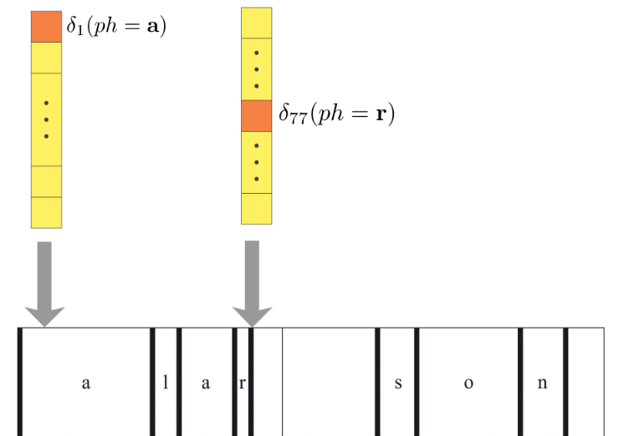
Duration-explicit hidden Markov model
Consider the sequence of phonemes as a HMM
Forced Viterbi alignment
Maximize duration at each phoneme according to assigned distributions

Slide 20
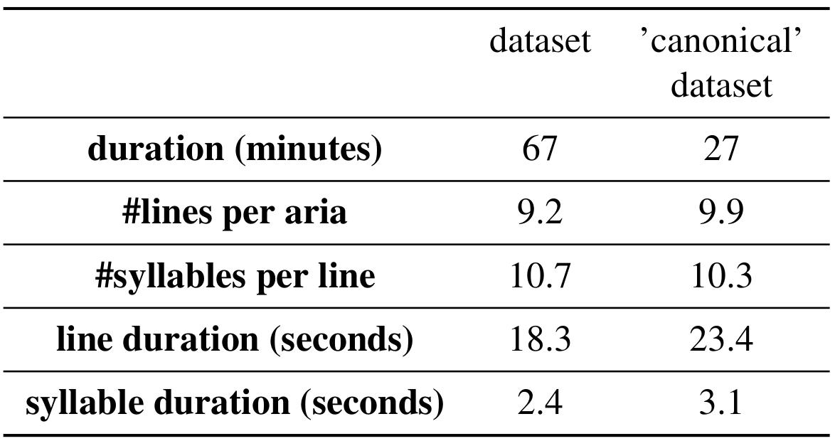
Dataset
Especially compiled for this study, 2 singers
'canonical' dataset: at least two prolonged key syllables
Notes:
3-fold cross validation

Slide 21
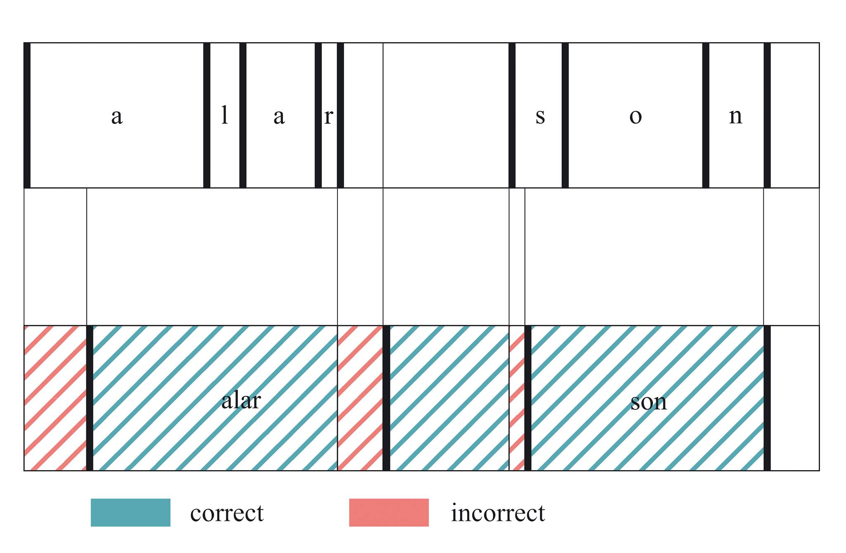
Evaluation metric
Alignment accuracy = duration of correct regions / total audio duration
Suggested in (Fujihara, 2011)
Notes:
Strictest metric, no tolerance window

Slide 22
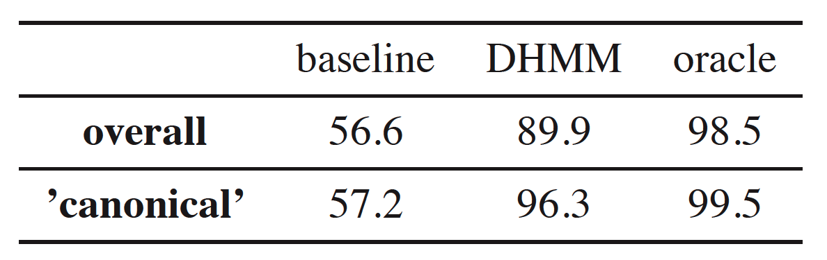
Results
3-fold cross validation done
baseline: same HMM with no duration modeling
oracle: same DHMM with annotations as if they were acoustic probabilities

Slide 23
Demo
Efficient python implementation available under CC license:
https://github.com/georgid/AlignmentDuration/tree/noteOnsets/jingju

Slide 24
Future work
Extend to work with original polyphonic mix
Integrate automatic segmentation of lyrics lines

Slide 25
References
(Fujihara, 2012): Lyrics-to-audio alignment and
its application. Multimodal Music Processing
(Dzhambazov et al. 2015): Modeling of phoneme
durations for alignment between polyphonic audio and
Lyrics. In Sound and Music Computing Conference,
Maynooth, Ireland.
(Kruspe et al. 2015): Keyword spotting in a-capella singing.
In Proceedings of the 15th International Society for Music
Information Retrieval Conference
(Fujihara, 2011): Lyric-synchronizer: Automatic synchronization system between musical audio signals and lyrics. IEEE Journal of Selected
Topics in Signal Processing

